Slide 1
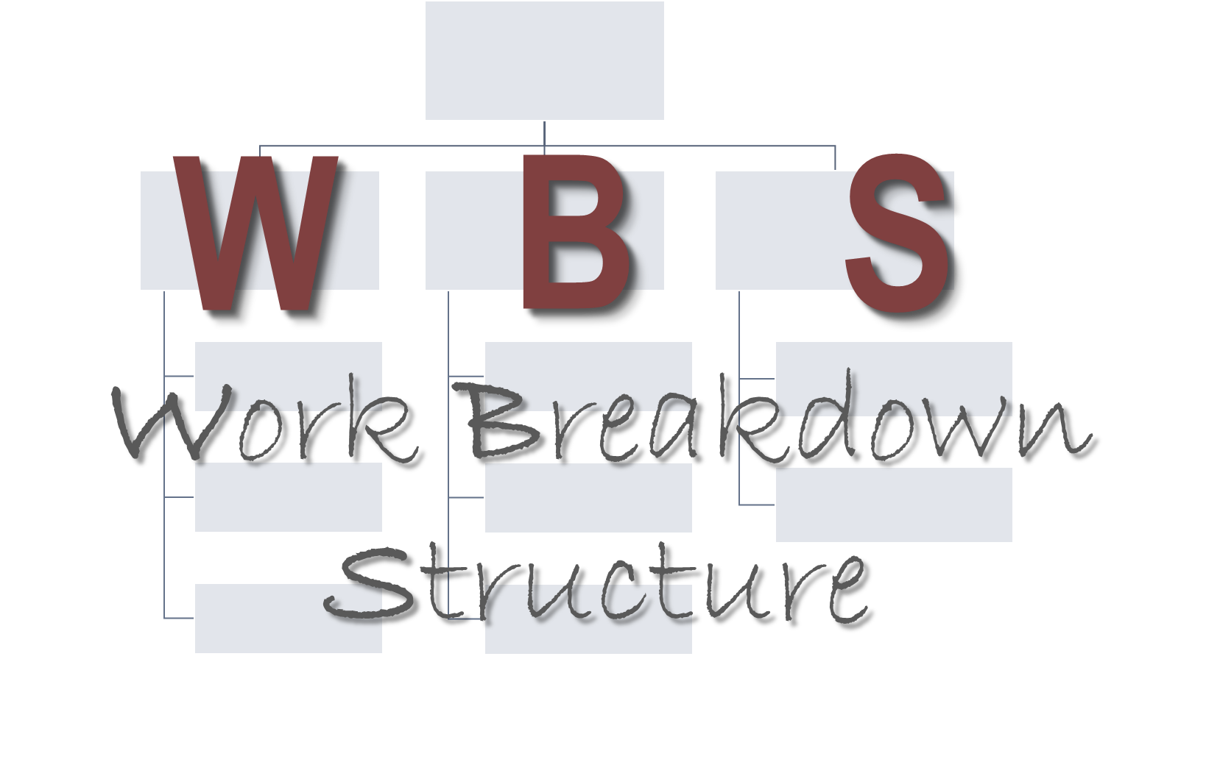
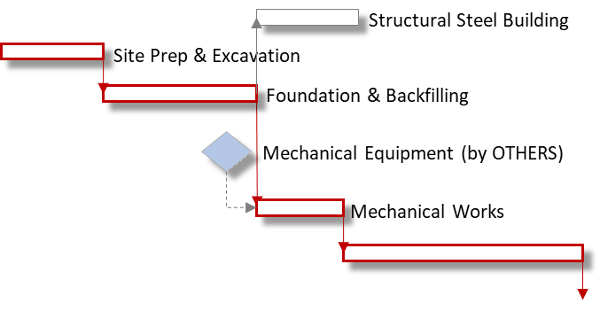
Project Fails due to Inadequate WBS
The solid foundation every stakeholder must know
PMI – Adelaide Chapter

Slide 2
Mechanics of WBS
Definition
WBS Progression (Owner – Contractor)
Basic WBS
Level Categories
Contracting, Manageable, and WP Zones
Strategic Boundaries
Backward Pass Approach
WBS Association
Role of Key Milestones
Resource Assignment
Inter-discipline Interface
Area /Section Based vs Discipline Based
Better Accountability
Competition
Visibility
Risk Management & Change Management

Slide 3
Basic WBS
- Definition
A hierarchical decomposition of the total scope to be carried out by the project team to accomplish the project objectives & create the required deliverables (by PMBook).
It visually defines the scope into manageable chunks that a project team can understand, as each level of the work breakdown structure provides further definition and details.
Level Categories (Level 0, 1, 2, 3, and so on) is not constant. It depends on the stakeholder’s perspective in reference to the project organization.
Categories may change depending on the what stage you are in the PM process. It may evolve to totally new categories. And it may grow as the work progresses through the project life cycle.
May be the driver to Contracting Strategy and Risk Management or vice versa.
Involvement of the PM is key to it’s development.
Note 1: WBS must focus on how the WORK will be better executed.
Note 2: WBS is not what will make it easy for estimating, cost allocation, OBS, RBS, etc.
Note 3: Don’t over complicate it but make it Organized and Consistent.

Slide 4
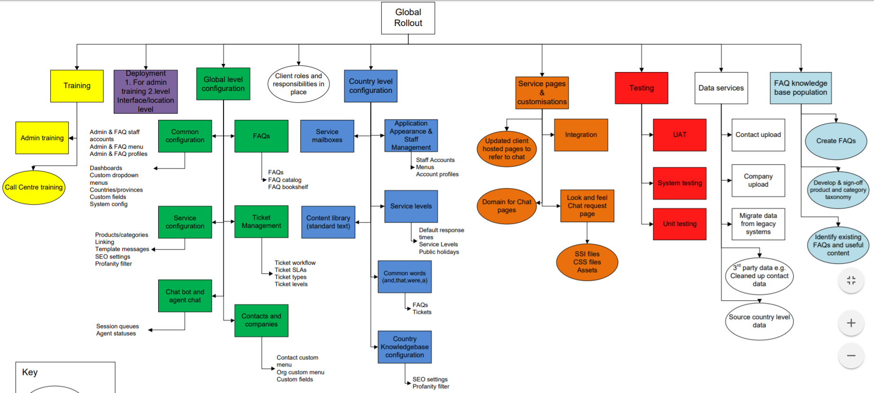
Basic WBS
- Exercise 1

Slide 5
Basic WBS
- WBS Progression (Owner – Contractor) (NOTE: PM Processes may overlap)
EBS, CBS, RBS, OBS are developed
Detailed Design / Scope Build up
Construction / Implementation
Go or No Go
Prelim Design
Bid / Sourcing
Procurement
Commissioning
Level 0
Level 1
Level 2
Level 3
Level 4
Level 5
Initiating
Planning
Executing
Closing
Owner
Note 4: The Owner should influence through the Contract the WBS categories (Level 4 at the minimum).
Contractor
Level 4, 5 & so on
Note 5: Always determine where your Level 0 is in the overall project organization.
Initiating
Planning
Executing
Closing
Level 0
Level 1
Level 2
Level 3
Bid or No Bid
Bid Prep
Pre-Works
Construction
Commissioning

Slide 6
Basic WBS
- Determining Levels
What happens if the certain level is not applicable?
Level 0
Portfolio / Program / Project Name
Data Centers
Level 1
Constraints (geographic, time, business, systems)
Seattle
LA
Austin
NY
Contracting
Level 2
EPCC
E&P
Construction
Commissioning
(Level 0)
Major Section / Area
Section 1
Section 2
Section 3
Section 4
Level 3
(Level 1)
Manageable
Level 4
Sub Section / Area
Section (Gen)
Section 3.1
Section 3.2
Section 3.3
Section 3.4
(Level 2)
WP
Level 5
Discipline / Expertise
Civil & Mech
E&I
Hardware
Software
(Level 3)
Note 6: Each level must be consistent and on the same category. DIRECT work package related or deliverable based only.
Note 7: Avoid as much as possible to use Discipline / Expertise category before Section / Area category.

Slide 7
Basic WBS
- Contracting, Manageable, and WP Zones
Contracting Level – It is the level that you may award to third parties to perform /execute. As a PM due diligence must be observed in performing proper Risks assessment as a result of the Contracting strategy.
Manageable Level – it is a level where as a PM you expect to be able to drill down in terms of reporting. It is the level where it is multi-discipline or it patterns the scope of the overall project (just a smaller version of it).
Work Package (WP) Level - it could be the deliverable. It is the level where the responsible resource is “specialized” to perform the package.
Note 8: These three classifications need especial attention and as much as possible must fall within two level range only. These zones can overlap each other.

Slide 8
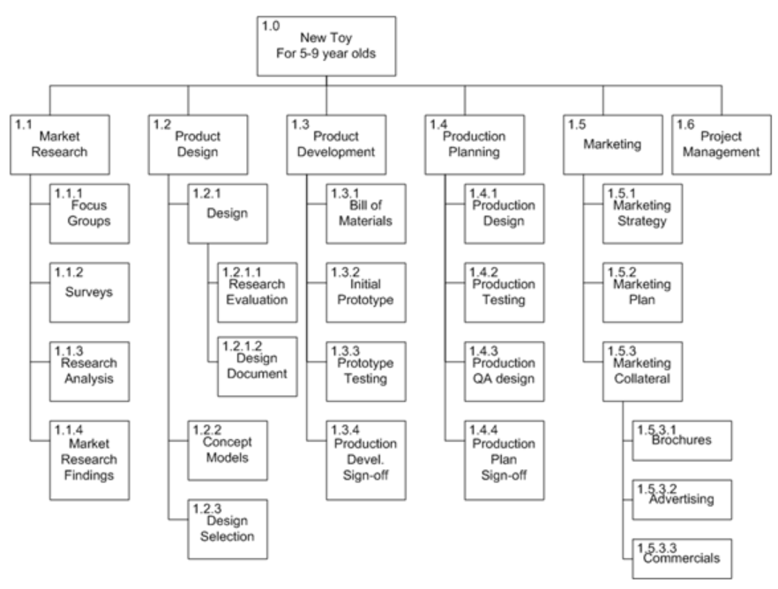
Basic WBS
- Exercise 2
projectinsight.net

Slide 9
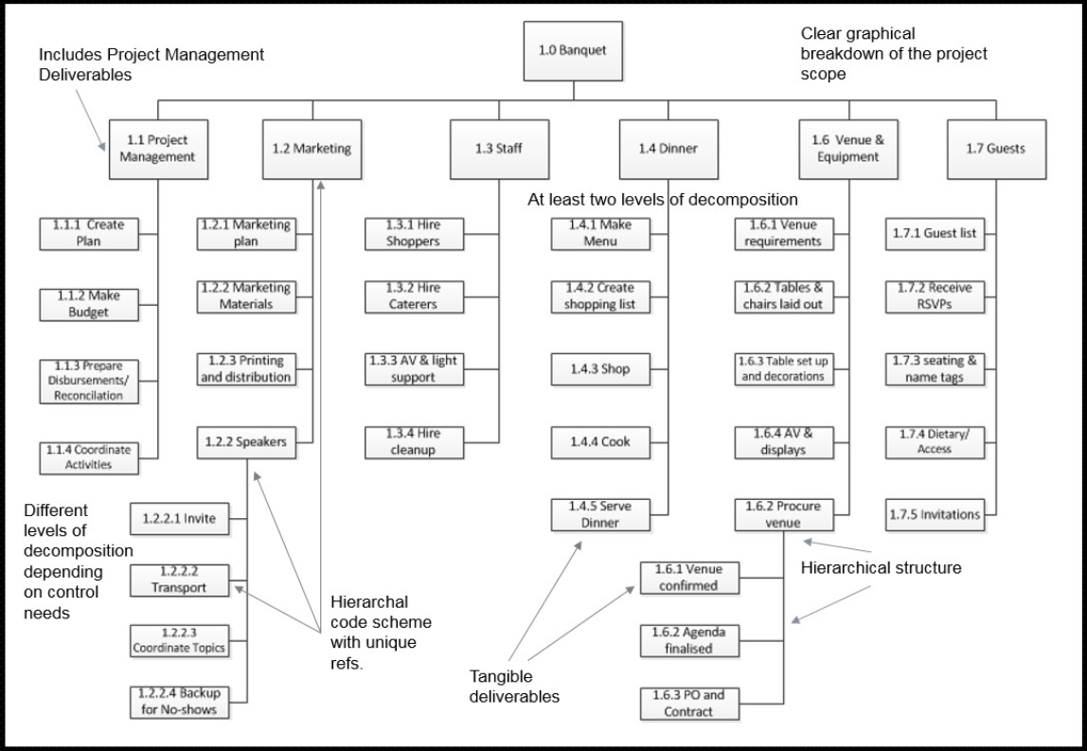
Basic WBS
- Exercise 2

Slide 10
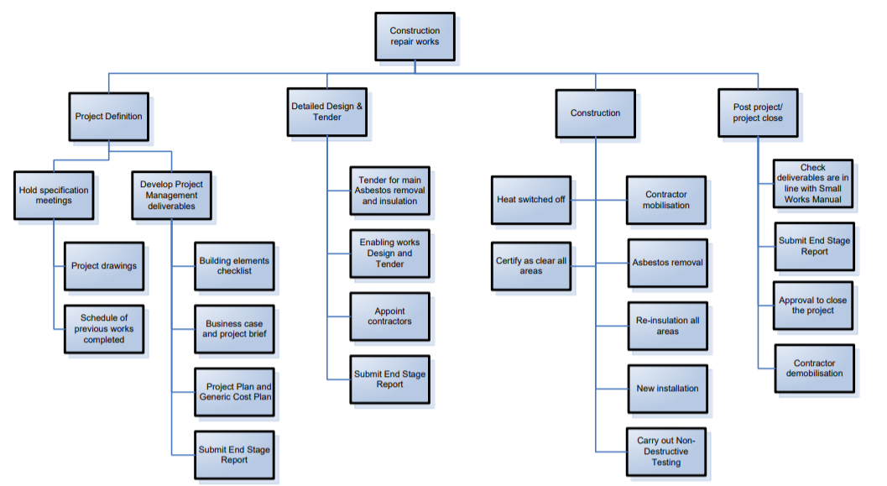
Basic WBS
- Exercise 2

Slide 11
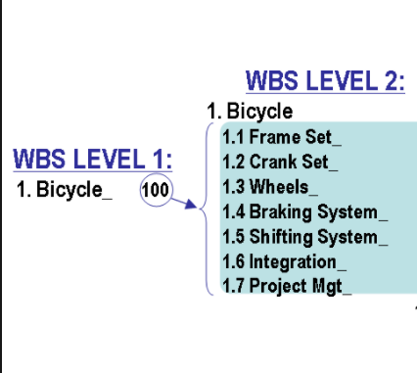
Basic WBS
- Exercise 3
commons.wikimedia.org

Slide 12
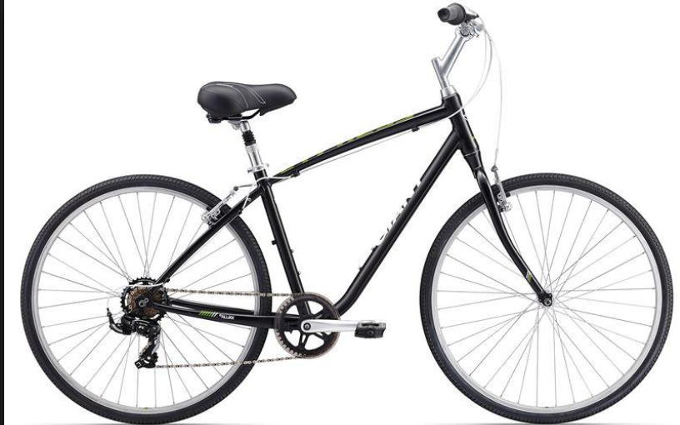
Basic WBS
- Exercise 3
Build 1000 units of bicycle
commons.wikimedia.org
takomabicycle.com

Slide 13
Basic WBS
- Exercise 3
Build 1 unit of bicycle (fully functional)
Metropolis City
Gotham City
City of Atlantis
Themyscira City

Slide 14
Basic WBS
- Strategic Boundaries
The boundaries or demarcation line you will use to divide your project into section.
Expert judgment is the key tool to determine it.
Criteria may be geographic advantage, system based, constructability and reliability focused.
Size may not be uniform nor level of complexity.
Note 9: In creating groups make sure not to create unnecessary Interfaces.

Slide 15
WBS Association
- Backward Approach
Prelim Eng.
Engineering
Procurement
Construction
Commissioning
System 1
Area 1
Area 1
Area 1
System 1
System 2
Area 2
Area 2
Area 2
System 2
System 3
Area 3
Area 3
Area 3
System 3
System 4
Area 4
Sub Area 3.1
Sub Area 3.1
System 4
Sub Area 3.2
Sub Area 3.2
Sub System 4.1
Sub Area 3.3
Sub Area 3.3
Sub Area 3.4
Civil & Mech
Sub System 4.2
Sub Area 3.5
E&I
Sub System 4.3
Design to Implement
Hardware
Sub System 4.4
Area 4
Software
Sub Area 3.4
Note 10: The phase(s) proceeding Construction / Implementation should adapt its WBS levels.
Sub Area 3.5
Area 4

Slide 16
WBS Association
- Role of Key Milestones
Use Key Milestones to drive the sequence of work (high level) and include it in the contract.
Milestone criteria may include business need, operations need, constructability & reliability aspects.
Critical systems and processes on the WBS Level 1 must be included as a Key Milestone.
Note 11: Don’t assume Key Milestones are fit as a WBS category.

Slide 17
Section vs Discipline
- Resource Assignment
PM
Construction
Section Based
Note 12: You get the benefit of having to assigned mini-PM with mini sections of the project.
Section 1
Section 2
Section 3
Section 4
DPM1
DPM2
DPM3
DPM4
Section 3.1
Section 3.2
Section 3.3
Section 3.4
Note 13: Depending on the size of your project, you can assign multiple mini-projects to one person.
PE3
PE1
PE2
PE1
Civil & Mech
E&I
Hardware
Software
DL
DL
DL
DL
Construction
Discipline Based
Note 14: This set up is only adequate if the project is relatively small.
Civil & Mech
E&I
Hardware
Software
DL
DL
DL
DL
Section 1
Section 2
Section 3
Section 4
PE1
PE1
PE2
PE2

Slide 18
Section vs Discipline
- Inter-discipline Interface
PM
Construction
Section Based
Note 15: Your mini PMs will handle the inter-discipline interface since it the part of his team.
Section 1
Section 2
Section 3
Section 4
PE
PE
PE
PE
Civil & Mech
E&I
Hardware
Software
DL
DL
DL
DL
Construction
Discipline Based
Note 16: The set up automatically creates many Interface amongst disciplines. If issues arises, the organization may need to employ coordinators, interface engineers /managers.
Civil & Mech
E&I
Hardware
Software
DL
DL
DL
DL
Section 1
Section 2
Section 3
Section 4
PE
PE
PE
PE

Slide 19
Section vs Discipline
- Better Accountability
PM
Construction
Section Based
Note 17: The mini PMs is held liable on the package assigned to him from beginning to end. The mini PM will make sure all deliverables pre requisite to execution is provided and all issues are addressed.
Section 1
Section 2
Section 3
Section 4
PE
PE
PE
PE
Civil & Mech
E&I
Hardware
Software
DL
DL
DL
DL
Blame
Blame
Blame
Discipline Based
Construction
Note 18: On a discipline based Level 1, the discipline lead may blame others on issues relevant to other disciplines. The discipline lead is not obligated to study the specifications, design, constraints, risks with other disciplines.
Civil & Mech
E&I
Hardware
Software
DL
DL
DL
DL
Section 1
Section 2
Section 3
Section 4
PE
PE
PE
PE

Slide 20
Section vs Discipline
- Competition
PM
Construction
Section Based
Note 19: The playing field is almost equal since then this may create an environment of healthy competition.
Section 1
Section 2
Section 3
Section 4
PE
PE
PE
PE
Civil & Mech
E&I
Hardware
Software
DL
DL
DL
DL
Construction
Discipline Based
Note 20: The packages are distinct that it is not comparable to create competition.
Civil & Mech
E&I
Hardware
Software
DL
DL
DL
DL
Section 1
Section 2
Section 3
Section 4
PE
PE
PE
PE

Slide 21
Section vs Discipline
- Visibility
PM
Construction
Section Based
Note 21: Progress or Issues are better analyzed when you can visualize it on where it occurs. Where the area affected can easily be isolated and apply relevant analysis.
Section 1
Section 2
Section 3
Section 4
DPM1
DPM2
DPM3
DPM4
Section 3.1
Section 3.2
Section 3.3
Section 3.4
PE1
PE2
PE1
PE3
Civil & Mech
E&I
Hardware
Software
DL
DL
DL
DL
Construction
Discipline Based
Note 22: Though the areas or section may be visible but you have to liaise with multiple stakeholders
Civil & Mech
E&I
Hardware
Software
DL
DL
DL
DL
Section 1
Section 2
Section 3
Section 4
PE1
PE
PE
PE

Slide 22
Section vs Discipline
- Risk Management & Change Management
PM
Construction
Section Based
Note 23: Where there is visibility, few points of contact, less interface, then Risks, changes and claims are more easily managed. The Mini PM shall serve as the risks owner, change management champion for his package.
Section 1
Section 2
Section 3
Section 4
DPM1
DPM2
DPM3
DPM4
Section 3.1
Section 3.2
Section 3.3
Section 3.4
PE1
PE2
PE1
PE3
Civil & Mech
E&I
Hardware
Software
DL
DL
DL
DL
Note 24: A single risks item or change order that affects multiple section may require more people to coordinate. In terms of risks management and change management implementation the project may require additional resource as Risks Manager, change order coordinator, package champion etc.
Construction
Discipline Based
Civil & Mech
E&I
Hardware
Software
DL
DL
DL
DL
Section 1
Section 2
Section 3
Section 4
PE1
PE
PE
PE

Slide 23
End
Website:
www.thinkhighlevel.com
<Free Download Section>
Email:
gmedalla@thinkhighlevel.com
LinkedIn:
Gholan Medalla

