Slide 1
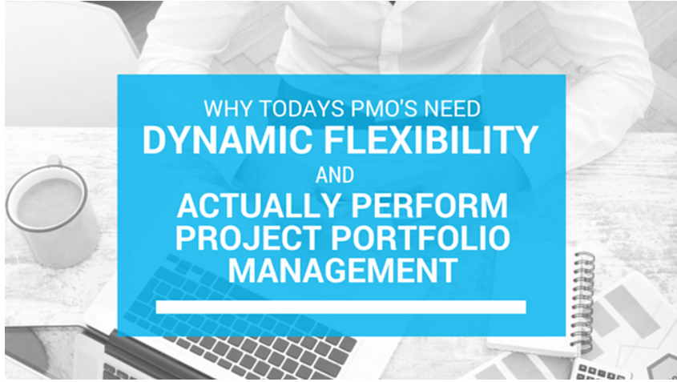
Laith Adel
Microsoft V-TSP

Slide 2
Why have a PMO?
To give the business better visibility and clarity on the projects and/or programmes being delivered
To deliver coordination that is difficult to achieve on an ad hoc project management basis
To ensure governance and improve success rates
To ensure initiatives alignments to the organisation strategic objectives and goals

Slide 3
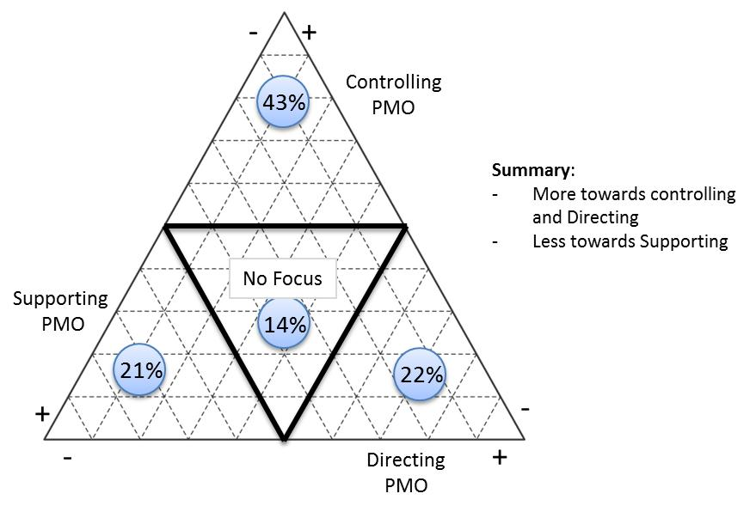
Types of PMOs

Slide 4
What is the expectation?
Achieving more goals, benefits and objectives that support the businesses changing strategies and tactics, not achieving more projects and programs
Quite often achieving more with less (money and resources)
Project Portfolio Management

Slide 5
What is the challenge?
Having portfolios’ objectives and goals (not deliverables) clearly defined, portfolios allocated and budgets clearly specified – This is done on a C-Level (CEO / CFO / COO) or board level, however PMOs need to ask the question very clearly and request/demand for it to happen i.e. tell us; “What do you want to achieve by giving us this budget?”
Manage and optimise those portfolio(s) to deliver their objectives and benefits within their budgets, this is often considered a mix of art and science

Slide 6
The Problem
Overestimating: Not wanting to be blamed for spending ‘more’ than the estimate (i.e. the budget), in another words, driven by the classical KPI of delivering projects within budget. Which leads to underrunning, i.e. not being able to spend the money or utilise the resources as per the original budget, this can be looked at as a good thing in some – not all – organisations (finishing your project with less money is an ideal situation for many project managers, but is it?
Underestimating: Creates a culture of “use it or lose it”, which defiantly isn’t the fix. Again some – not all – organisations look at spending the money and resources as per budget is a good thing, but is it?

Slide 7
The Traditional Solution
It’s easy: Training, skilling people up in Estimation and having the right tools, to get proper estimation. But is it?
But the fact is even, organisations with high maturity , are still finding that estimation in the “Initiation, Evaluating and even Planning” phases can be a bit or a lot, of what’s eventually required to be spent (even with contingencies), and the accurate estimates (‘100% accurate estimation) can only happen in the “Execution” phase.

Slide 8
The Pragmatic Solution
Gain the project mangers’ or (BAs) trust to estimate accurately and realistically (i.e. eliminate the phobia of going ‘over budget)
Establish a sense of security for the project managers, by making sure that when those project managers need more money and resources to achieve their project objectives, the PMO will be there to make it happen (through a change request process)
Implement an going trade off process (REQUEST / RELASE) in projects within a certain portfolio.
A project (in flight or closed) that has a “Revised Budget” that is less than its “Original Budget” will RELEASE money and resources to the portfolio and a project (in flight only) that has a “Revised Budget” more than “Original Budget” will REQUEST money and resources.
The PMO’s role is not only to facilitate and govern this (RELEASE / REQUEST) process, but he is accountable for keeping the bottom line of the portfolio budget balanced (i.e. no surplus or deficit) in the portfolio budget. See example below:

Slide 9
Balancing the Portfolio – Example

Slide 10
Performance Monitoring
Monitor projects (i.e. Actuals – of money or resources) against the two Budgets (Original and Revised) separately.
Each comparison is measuring different thing. When comparing the ‘Actuals’ vs. ‘Original Budget’ , it’s measuring and monitoring Estimation competency (which is important, to see if investment in enhancing the Estimation competency, through training and/or process and tools is required).
Comparing the ‘Actuals’ vs. ‘Revised Budget’, in this case it’s measuring the performance of the Execution competency (which is not only important to see if Execution area need some enhancements, but to monitor the (RELEASE / REQUEST) process)
See sample charts below showing actuals deviation from Original and Revised budgets:

Slide 11
Monitoring Performance - Examples

Slide 12
What if the portfolio has only deficits and no surpluses?
It is underestimating problem (i.e. the estimation competency itself) more than portfolio balancing. So investing in estimation skills, tools , etc could be a solution.

Slide 13
What if the balance is in surplus?
It depends on the frequency of your (REQUEST / RELEASE) cycle, if it frequent (for example monthly), doing nothing for at least a quarter, in case requests are coming.
If there is still a surplus
Return back to the business
Achieve ‘optional objectives’ buy approving more projects.

Slide 14
Microsoft PPM Functions / Microsoft Project Online
PPM
Program
Management
Demand
Management
Portfolio Analytics & Selection
Time
Reporting
Issues & Risk
Management
Business Intelligence & Reporting
Team Collaboration & Social
Financial Management
Resource Management
Schedule Management

Slide 15
Demo

Slide 16
Project Online Trail - Project & Portfolio Management Proof-of-Concept
EPM Partners’ PPM Proof-of-Concept (PoC) is a free-of-charge package of services that allow you test drive Microsoft Project Online, configured for you.
What You’ll Get
A day of an experienced senior PPM consultant’s time that includes a Getting-Started workshop
A fully functioning, cloud-based Microsoft PPM PoC system, with basic configurations to suit your needs
Up to three user log-ins for 30 days
A system usage guide

Slide 17
Project Online FAQ
What does it cost ? | Nothing, it’s free of charge for 30 days
How many users can I have ? | 3 user logins are allowed
Is it built on the latest software ? | Yes, the PoC is rolled-out on Microsoft Project Online
Will it be set-up for me ? | Yes, our consultant will spend a day workshopping your basic requirements and configuring the PoC for you.
What hardware do I need ? | Just your laptop and a browser
Can I keep it afterwards ? | Yes, we’ll set you up as a Project OnLine customer and you can continue to use it.
What do I do next ? | Call 1300 123 376 or email Stuart.Penny@epmpartners.com.au

